Slide 1

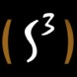
Functional Abstractions for Practical and Scalable Concurrent Programming
KC Sivaramakrishnan

Slide 2
Concurrent programming is (still) hard!
Notes:
Developing safe and scalable concurrent programs remains a difficult endeavor, and is a major theme of current research. The number of papers on concurrent programming abstractions, verification an debugging in top conferences is quite substantial. The reason for this level of activity is quite warranted..

Slide 3
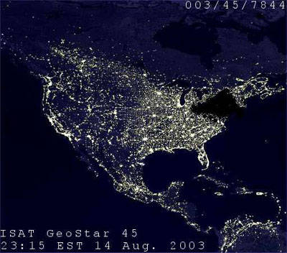
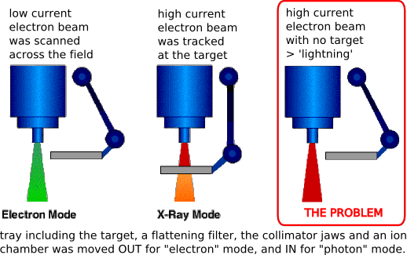

Concurrency bugs can be disastrous
2003 Northeast blackout^{[1]}
Race disables alarm system
Effect
256 power stations go offline
~7 hr major blackout
11 fatalities, $6 billion
Therac-25 incidents^{[2]}
Race b/w UI and controller
6 fatalities
Facebook IPO @ NASDAQ^{[3]}
Race between validation and new orders arrival
NASDAQ compensation = $62 million
[1] http://www.scientificamerican.com/article/2003-blackout-five-years-later/
[2] http://sunnyday.mit.edu/papers/therac.pdf
[3] http://www.cnbc.com/id/100587334
Notes:
When concurrency bugs get into real-world code, the results can be disastrous.
The 2003 Northeast black out was attributed to a race condition that disabled the alarm system. This resulted in 256 power stations to go offline, causing a 7hr major blackout between in most of the north east united states. The blackout was attributed to 11 fatalities and $6 billion in damages.
In the 80s, race condition between the UI and the controller in therac-25 radiation therapy machines caused 6 fatalities and numerous other injuries.
On the day of Facebook IPO on NASDAQ, a race condition in NASDAQ code between order validation transaction and new orders arrival caused slowdown of trades for 30 minutes. The resultant confusion over prices lasted for a day. Ultimately, NASDAQ had to pay $62 million in damages to investors.
Hence, it is in everyone’s interest that the code that we write does not have any concurrency bugs.

Slide 4




Data race
Deadlock
Safe and scalable
concurrent program
Weak memory
semantics
Fences, Locks,
Condition variables, etc.
Eventual
consistency
No cache
coherence
Atomicity
violations

Slide 5
Stick to Status Quo
Testing
Verification
PL Support
Safe and scalable
concurrent program
Notes:
We can stick to status quo, and let the expert programmer worry about writing correct concurrent code. If the current trends are anything to go about, the concurrent programming is not only going to become common, but it also going to get harder.
We can test our concurrent programs for bugs. But as Dijkstra famously observed, testing can only show the presence of bugs not the absence of it. In addition, non-determinism in concurrent programs make concurrent bug testing very difficult.
Perhaps, the most promising approach is verification of concurrent programs for functional correctness. However, complete verification of concurrent programs remains difficult due to complexities of real-world systems. But certainly, concurrent program verification techniques continues to remain the domain of experts.
In this talk, I believe that programming language support can help average programmer write safer, more scalable programs. Right programming language abstractions can mitigate concurrency errors by making them impossible by construction. Of course, PL support has to be complimented with techniques like testing and verification to improve the robustness.

Slide 6
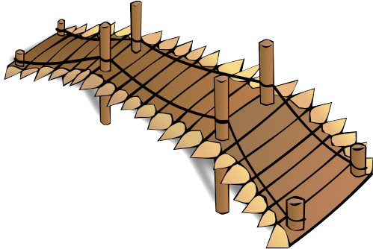

Data race
Deadlock
Safe and scalable
concurrent program
Weak memory
semantics
Functional programming abstractions
Eventual
consistency
Non-cache
coherence
Atomicity
violations
Notes:
I believe that functional programming languages can bridge the gap between the average programmer and safe, scalable concurrent programs. With its expression oriented syntax, higher-order functions, and the lack of pervasive side-effects make it an attractive model for concurrency.

Slide 7
Programming abstractions simplify Concurrent Programming
Transactional
Memory
Multicore Garbage
Collection
Notes:
Programming abstractions such as transactional memory and multicore garbage collection simplify concurrent programming by relieving the programmer from worrying about manually managing shared memory and thread communication and coordination. This lets the programmer to focus on the more important details such as translating their algorithm to a program.

Slide 8

But, programming abstractions introduce a level of indirection
Transactional
Memory
Multicore
Garbage
Collection
Slower than locks
under high contention
Parallel → throughput
Concurrent → pause times
Notes:
However, abstractions introduce a level of indirection between the programmer and the target platform, adding to performance penalties. For example, transactional memory is typically slower than locks under high contention. And, several multicore GCs alternatives exist, each optimizing towards a particular goal, making compromises on others. Hence, choosing the right abstraction is vital for scalability.

Slide 9
Safety
&
Simplicity
Performance
&
Functionality
Always desirable to marry the two whenever possible!
Notes:
Thus, While designing and implementing new concurrency abstractions, there are always two competing goals. On the one had you have the safety and simplicity of the new abstractions. But on the other, you have more pragmatic constraints such as performance and functionality. It is always desirable to marry the two whenever possible.
This has been the common theme of my PhD research.

Slide 10


MultiMLton
Intel SCC
48-core Non-cache-coherent
Azul Vega 3
864-core CC-UMA
Compute clouds
Asynchronous CML [PLDI ’11, JFP ’14*]
Memoizing Communication [ICFP ’09]
Rx-CML – optimistic CML [PADL ’14]
Language Design
Runtime Systems
Parasitic threads [DAMP ’10, JFP ’14*]
Thread-local GC [ISMM ’12, MARC ’12, JFP ’14*]
Scheduler activations for Haskell
Schedulers for Haskell threads as Haskell libraries
[In submission to OOPSLA ’14]
Sting (Java)
Session type based protocol optimization
[Coordination ’10, SCP ’13]
* Accepted with revisions
Notes:
The main theme of my PhD research is the design and implementation of functional programming languages for future manycore systems and compute clouds.

Slide 11
This talk
1
2
Rx-CML
Concurrency
Substrate for Haskell
Notes:
The main theme of my PhD research is the design and implementation of functional programming languages for future manycore systems and compute clouds.

Slide 12
Rx-CML : An Optimistic Concurrency Control for CML
Joint work with
Lukasz Ziarek
Suresh Jagannathan

Slide 13
Synchronous
communication
Transactional
memory
Garbage
collection
Abstraction
Domain
Asynchronous distributed system
Shared memory concurrency
Memory management
Synchronous communication =
atomic { data transfer +
synchronization }
synchrony
latency
Notes:
The main idea of the work is that we believe synchronous communication can be an abstraction for programming asynchronous distributed systems just as transaction memory is to shared memory concurrency and garbage collection is to memory management.
A functional programming language combined with synchronous communication provides an attractive model for shared memory concurrency. The synchronous communication abstraction combines data transfer and synchronization into a single atomic unit. However, in a geo-distributed setting, the synchrony is at odds with high latency.

Slide 14
Can we discharge synchronous communications asynchronously and ensure observable equivalence?
Formalize:
Implement:
Distributed Concurrent ML in MultiMLton + Speculative execution framework
Notes:
A distributed implementation of Concurrent ML with a speculative execution framework, that discharges synchronous sends asynchronously, detects when this equivalence fails, and repairs failed executions.

Slide 15
Concurrent ML
val spawn : (unit -> unit) -> thread_id
val channel : unit -> ‘a chan
val send : ‘a chan * ‘a -> unit
val recv : ‘a chan -> ‘a
val sendEvt : ‘a chan * ‘a -> unit event
val recvEvt : ‘a chan -> ‘a event
val sync : ‘a event -> ‘a
val never : ‘a event
val alwaysEvt : ‘a -> ‘a event
val wrap : ‘a event -> (‘a -> ‘b) -> ‘b event
val guard : (unit -> ‘a event) -> ‘a event
val choose : ‘a event list -> ‘a event
...
Thread creation
Synchronous message passing
First-class events

Slide 16
T1
T2
T3
A
send(c1,v1)
recv(c2)
send(c2,v3)
f()
B
g()
h()
send(c2,v2)
recv(c1)
recv(c2)
C

Slide 17
T1
T2
T3
C
asend(c1,v1)
recv(c2)
✘
send(c2,v3)
f()
g()
h()
A
B
send(c2,v2)
recv(c1)
recv(c2)
Theorem:
Cyclic dependence ⇒ divergent behavior

Slide 18
Distributed group chat app
No central server & causal dependence
→ causal broadcast
synchronously distribute values
prevent receiver threads from proceeding
Notes:
With purely asynchronous point-to-point communication, one needs to maintain vector clocks and buffering on the receiver side to implement a causal broadcast primitive.
With point-to-point synchronous messaging, causal broadcast primitive can be implemented in a straight-forward manner! Cyclic dependence ⇒ divergent behavior
It is easy to see that this implementation would not scale as phase 2 is a global barrier.
Our idea, take the above synchronous program, discharge the sends asynchronously, detect and remediate causal dependences.

Slide 19
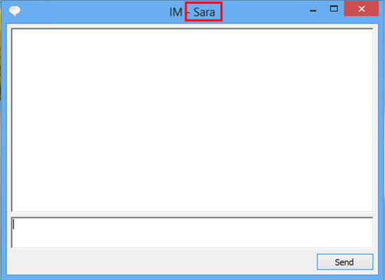

Distributed group chat app
Display thread
show (m)
bsend (m)
IP thread
show (m)
brecv (m)
Listener thread
Notes:
With purely asynchronous point-to-point communication, one needs to maintain vector clocks and buffering on the receiver side to implement a causal broadcast primitive.
With point-to-point synchronous messaging, causal broadcast primitive can be implemented in a straight-forward manner! Cyclic dependence ⇒ divergent behavior
It is easy to see that this implementation would not scale as phase 2 is a global barrier.
Our idea, take the above synchronous program, discharge the sends asynchronously, detect and remediate causal dependences.

Slide 20



Stan
Kyle
Kenny
Display
IP
Listener
Display
IP
Listener
Display
IP
Listener
show (X)
brecv (X)
brecv (Y)
X
show (X)
show (Y)
bsend (X)
X
show (Y)
Y
Presume causal dependence X → Y
Y
bsend (Y)
brecv (X)
show (X)
Causal dependence violated!
X
Cycle Detected!

Slide 21
Distributed group chat app: Performance
US East
EU
US West
Execution | Avg. time (ms) | Errors (per1000 iters)
Sync | 1540 | 0
Execution | Avg. time (ms) | Errors (per1000 iters)
Sync | 1540 | 0
Unsafe Async | 520 | 7
Execution | Avg. time (ms) | Errors (per1000 iters)
Sync | 1540 | 0
Unsafe Async | 520 | 7
Safe Async (Rx-CML) | 533 | 0
Notes:
We simulated the previous example on 3 geo-distributed Amazon EC2 nodes, and repeated the communication patter for 1000 iterations.

Slide 22
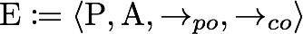
Formalization
Reason axiomatically
Actions
Send, Recv, Fork, Join, Begin, End, Print
Happens-before relation
Well-formed execution Obs (WF_Exec (P)) ∈ {Obs (Sync_Exec (P))}
Theorem
All Executions
No happens before cycle
Sensible intra-thread semantics
No outstanding speculative actions
Well-formed executions
Sync Executions
Recipe for implementation
Notes:
We reason about our executions, speculative or otherwise, using an axiomatic framework. The axiomatic formalization is similar to the ones used to describe the semantics of shared memory concurrent programs on modern multicore processors. Executions is composed of a set of actions or events that matter, and the relation between the events. A happens before relation, expressed as a transitive closure over the primitive relations, captures the visibility and ordering relation between the events
Our formalization shows that for any execution that satisfies these these properties, there exists a equivalent CML execution. Interpret these properties as a recipe for implementation.

Slide 23
Implementation
Dependence graph ≡ Axiomatic execution
WF check before observable actions
Ill-formed? Rollback and re-execute non-speculatively – Progress!
Checkpoint
1 continuation per thread + Communication log
Checkpoint & Rollback is uncoordinated!
Channel consistency
Preserve CML semantics
Multi-producer, multi-consumer
Reliable send, exactly-once consumption
Channel state replicas at each site
Asynchronously (convergence || inconsistency)
Notes:
Preserve CML semantics – CML channels are multi-producer, multi-consumer channels. The source and destination of messages are not known a-priori

Slide 24

Channel Consistency (1)
Site 1
Site 2
Site 3
send(c1,0);
recv(c1);
{c1:[],c2:[]}
s(c1,0)
{c1:[s(0)],c2:[]}
{c1:[s(0)],c2:[]}
s(c1,0)
{c1:[s(0)],c2:[]}
request_to_match(c1)
{c1:[],c2:[]}
Flush unconsumed
send!
{c1:[],c2:[]}
match (s(c1,0) + r(c1))
Success
{c1:[],c2:[]}
{c1:[],c2:[]}

Slide 25
Channel Consistency (2)
Site 1
Site 2
Site 3
send(c2,1);
recv(c2);
Concurrent
execution!
recv(c2);
{c1:[],c2:[s(1)]}
s(c2,1)
{c1:[],c2:[s(1)]}
s(c2,1)
{c1:[],c2:[s(1)]}
{c1:[],c2:[r2]}
request_to_match(c2)
{c1:[],c2:[]}
request_to_match(c2)
{c1:[],c2:[]}
{c1:[],c2:[r2,r3]}
Lost exactly once semantics
First-come first-match
Success
Mis-speculation!
match (s(c2,1) + r2(c2))
Rollback

Slide 26
Results
Benchmark: Optimistic OLTP & P2P Collaborative editing
5.8X faster than sync
1.4X slower than async
@ 48 clients
7.6X faster than sync
2.3X slower than async
@ 6 authors
Rx-CML efficient abstraction over
high-latency distributed systems!
Notes:
Conclude in this slide. The results demonstrate that Rx-CML can be an effective abstraction for programming high-latency distributed environments.

Slide 27
Conclusion
Synchronous
communication
Rx-CML:
Speculative
Execution!
Asynchronous distributed system
synchrony
latency

Slide 28
A Lightweight Concurrency Substrate for Haskell
Joint work with
Tim Harris
Simon Marlow
Simon Peyton Jones

Slide 29

How to write schedulers for Haskell threads as Haskell libraries?
How to write schedulers for Haskell threads as Haskell libraries in GHC?
Concurrent Haskell Application
Haskell
Runtime System (RTS) - C
App Dev
MVar
Blackholes
GC
Interrupts
Scheduler
Async Exception
Safe FFI
STM
Lang Dev
Notes:
The main goal of this work is to allow Haskell programmers to write schedulers for Concurrent and Parallel Haskell threads as Haskell libraries. In this work, we focus on Glasgow Haskell Compiler.
The main challenge is that GHC’s runtime system is like an monolithic operating system kernel. It is feature rich, performance, but very hard to change. Part of this reason is due to the fact that the scheduler Is implemented in C is a part of the runtime system, and it intricately interacts with other RTS concurrency mechanisms.
From the language developer’s perspective, this hinders rapid research and experimentation into scheduler design. Improvements to schedulers can only be incorporated into new version of the compiler and runtime.
From the application developer’s perspective, the scheduler comes with a single scheduling policy: A Preemptive, work-stealing scheduler, with one run-queue per core. There is no reason to believe that this scheduler would be sufficient for all intents and purposes. The application developer is unable to specify application specific scheduling policies incorporating thread priority or gang scheduler.

Slide 30
Concurrent Haskell Application
User-level Scheduler
Haskell
App Dev
Lang Dev
RTS - C
Haskell ‘07
P. Li, S. Marlow,
S. Peyton Jones, A. Tolmach,
GC
MVar
Async Exception
Scheduler activations!
Blackholes
Interrupts
Safe FFI
STM
Notes:
As a first step, we can move our existing scheduler implementation from C to haskell, so that the application developers and language implementers can write schedulers in Haskell. But this is undesirable since every time a new scheduler needs to be implemented, one has to reason about and re-implement the interactions with the RTS concurrency mechanisms. What we need is an abstraction, that generalizes the individual interactions.
The abstraction we choose is scheduler activations. Scheduler activations have been previously utilized in the context of OS to allow user-level schedulers to scheduler kernel threads. In this work, we explore the use of activations in a language runtime.

Slide 31

Concurrent Haskell Application
User-level Scheduler
EnQ and DeQ
Activations
App Dev
Lang Dev
App Dev
Lang Dev
Haskell
RTS - C
Software Transactional Memory
Concurrency Substrate
GC
MVar
Async Exception
Blackholes
Interrupts
Safe FFI
STM
Notes:
The scheduler itself is implemented over a very small subset of primitives called the substrate.
The user-level scheduler is expected to expose two activations to the substrate, one to enqueue and another to dequeue threads from the scheduler.
The RTS performs upcalls to the activations to interact with the user-level scheduler.
Since multicore schedulers are themselves concurrent programs operating over , the scheduler writer can run into the usual pitfalls of concurrent programming. Luckily, since we are in Haskell, we can utilize the software transactional memory abstraction to avoid some of the concurrency errors by construction.

Slide 32
Concurrency Substrate API
One-shot continuations
Scheduler access is under STM
Notes:
The substrate exposes one-shot continuations to the programmer. And there are primitives to create, switch between SConts and initiate Scont execution in parallel.
Activations are simply functions associated with each Scont. If one considers Sconts are objects, then activations would be member functions. There are functions to access and update an Scont’s activations. The important feature of the signatures is that all the functions that access the scheduler are under STM.
Finally, the substrate provides an arbitrary thread local state slot, which is also accessed under STM.

Slide 33
RTS Interaction - Blocking
t.sched.dequeue()
User-level
RTS
takeMVar
t’
∅
takeMVar
MVar
∅
t
switch(dequeueAct t)
t
Current Thread
Current Thread

Slide 34
RTS Interaction - Unblocking
t.sched.enqueue(t)
User-level
RTS
takeMVar
t
v
∅
∅
putMVar
atomically(enqueueAct t)
Current Thread
t’
Current Thread
t’
Generalizes all of the RTS ↔ ULS interactions!
Notes:
All of the interactions between the RTS and the user-level scheduler fall into this pattern, and can be captured through scheduler activations!

Slide 35
Multicore capable, preemptive,
round-robin work-sharing scheduler
GC overheads
of ULS
Vanilla work-sharing
is too lazy?

Slide 36
Formalization
Concurrency Substrate
Upcalls from the RTS
Notes:
Describing the behavior of scheduler primitives is very tricky. Hence, we provide small-stop operational semantics, not just for the primitives in the concurrency substrate, but also for the interactions between the runtime systems and the user-level schedulers. This is very unusual, and it brought out subtle cases in the interaction between the user-level scheduler and the RTS, that had been overlooked in the implementation. One such example is interrupt handling.

Slide 37
Formalization – Interrupt Handling
GHC threads are preemptively scheduled
Context switch on timer interrupt
IO
E[M]
tick
E[yield >> M]
yield = switch(\x. enqueueAct x >> dequeueAct x)
atomically STM
tick
Suspend transaction and yield
E[atomically(P[M])]
??
Switch
STM
Disable interrupts under switch
to prevent livelocks.
E[switch(P[M])]
tick

Slide 38
Conclusion
User-level
Scheduler
???
Haskell
Haskell
RTS - C
RTS - C
Scheduler
Concurrency
Substrate
Scheduler activations
+
Software transactional memory
Notes:
----- Meeting Notes (3/30/14 11:16) -----
Summary at the end of timer interrupt

Slide 39

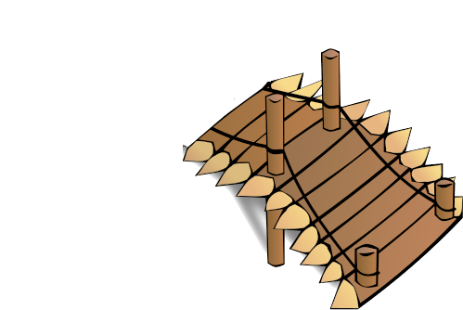
Opportunity for Collaboration!
Data race
Deadlock
Safe and scalable
concurrent program
FutureWork
Weak memory
semantics
My research
Eventual
consistency
Existing
work
Non-cache
coherence
Atomicity
violations

Slide 40
Future directions - GC Substrate
Parallel,
concurrent,
generational,
thread-local,
mark-sweep,
mark-compact,
copying,
Immix,
…
User-level
scheduler
User-level GC?
Haskell
RTS - C
Concurrency Substrate
GC
GC
Substrate
GC code can invoke itself!
Trigger GC and memory barriers
Similar to scheduler circularity issues
Do RTS GC for user-level GC code?
Notes:
Handing over core functionalities such as scheduling and GC to the Haskell programmer is risky. With our concurrency substrate, it is very easy to write a bad scheduler that loses threads or hogs a processors. CLICK!
In general, since scheduler is a concurrent program, verifying the scheduler is as difficult as verifying the program running on top. In our system, the scheduler is always accessed through STM. For the purpose of verification, we can consider the scheduler to be a sequential process!

Slide 41
Future directions:
Rx-CML → Eventually Consistent Programs
Rx-CML: Speculative Execution!
Consistency
Availability
Strong consistency
Mostly available
Bank account, Shopping Carts, Orderbooks
Datatype
definition
Consistency
Specification
Distributed spec. exec.
Operations are folds over execution trace
Application-level consistency
Rx-CML like WF Check @ runtime
Consistency
Specification
Z3
Dependence
Graph
Notes:
Handing over core functionalities such as scheduling and GC to the Haskell programmer is risky. With our concurrency substrate, it is very easy to write a bad scheduler that loses threads or hogs a processors. CLICK!
In general, since scheduler is a concurrent program, verifying the scheduler is as difficult as verifying the program running on top. In our system, the scheduler is always accessed through STM. For the purpose of verification, we can consider the scheduler to be a sequential process!

Slide 42
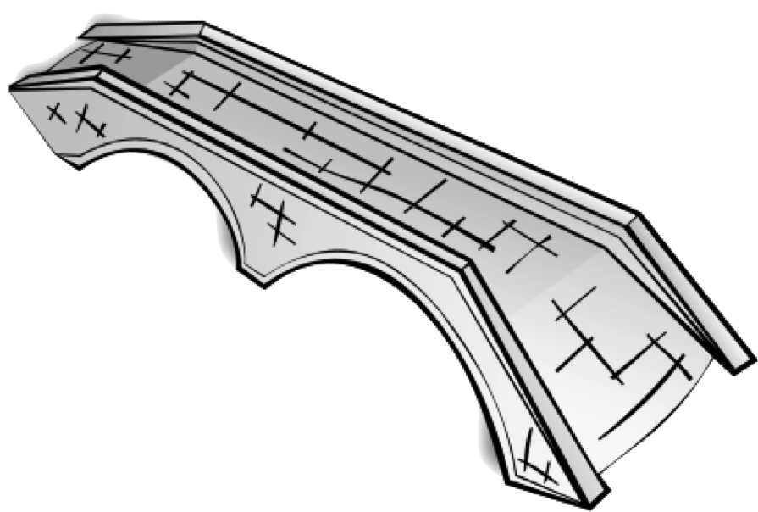
Data race
Deadlock
Safe and scalable
concurrent program
Weak memory
semantics
FP abstractions
+
Verification
Eventual
consistency
Non-cache
coherence
Atomicity
violations

Slide 43
Future directions – Verification
User-level
scheduler
Haskell
RTS - C
Concurrency Substrate
User-level schedulers can go wrong
Lose threads, hog processors, etc.
Verify the functional correctness of ULS
Correct Scheduler ⇒ Each thread runs as if given its own processor and register set
Scheduler access under STM ⇒ sequential process!
Notes:
Handing over core functionalities such as scheduling and GC to the Haskell programmer is risky. With our concurrency substrate, it is very easy to write a bad scheduler that loses threads or hogs a processors. CLICK!
In general, since scheduler is a concurrent program, verifying the scheduler is as difficult as verifying the program running on top. In our system, the scheduler is always accessed through STM. For the purpose of verification, we can consider the scheduler to be a sequential process!

Slide 44
Conclusion
Data race
Deadlock
Safe and scalable
concurrent program
Weak memory
semantics
Scalable FP abstractions
+
Verification, Testing, etc.
Eventual
consistency
Non-cache
coherence
Atomicity
violations
Thank you!

Slide 45
Backup Slides

Slide 46
Rx-CML vs Asynchronous Comm.
Our programs are network bound
Low-contention: cost of checkpointing (local continuation capture) + WF check is masked
Unit acknowledgements can be eliminated in Rx-CML
In RxCML, lock acquisition is speculative (profitable under low-contention)
Under async. comm., always pessimistic (block)
Asynchronous Comm.
Rx-CML
fun getLock (lockChan, ackChan) =
asend (lockChan, myId());
recv ackChan
fun getLock (lockChan) =
send (lockChan, myId())
Notes:
Transition between sections between smoother.

